Slide 1

Predict product stock levels hourly to optimize procurement
Cognizant’s technology-led clients,
Gala Groceries

Slide 2
About
Challenge:
Goal:
Hope:
Gala Groceries, known for local, fresh produce, needs help finding the sweet spot for stocking perishable items. Overstock = waste. Understock = lost customers.
Improve inventory management to minimize waste and satisfy customers.
Cognizant can provide the tech-savvy grocery chain with a solution to optimize its supply chain and maintain its fresh produce edge.

Slide 3
Table of contents
01
1.1
1.2
02
2.1
2.2
EDA
Visualisation
Summary
Modeling
Build Model
Conclusion

Slide 4

01
EDA

Slide 5
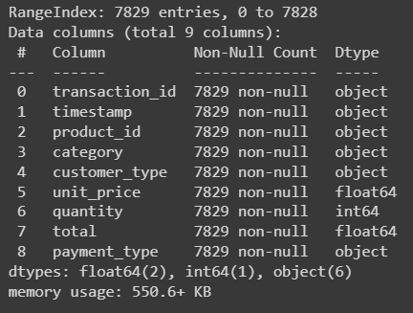
The sample data
transaction_id = this is a unique ID that is assigned to each transaction
timestamp = this is the datetime at which the transaction was made
product_id = this is an ID that is assigned to the product that was sold. Each product has a unique ID
category = this is the category that the product is contained within
customer_type = this is the type of customer that made the transaction
unit_price = the price that 1 unit of this item sells for
quantity = the number of units sold for this product within this transaction
total = the total amount payable by the customer
payment_type = the payment method used by the customer

Slide 6
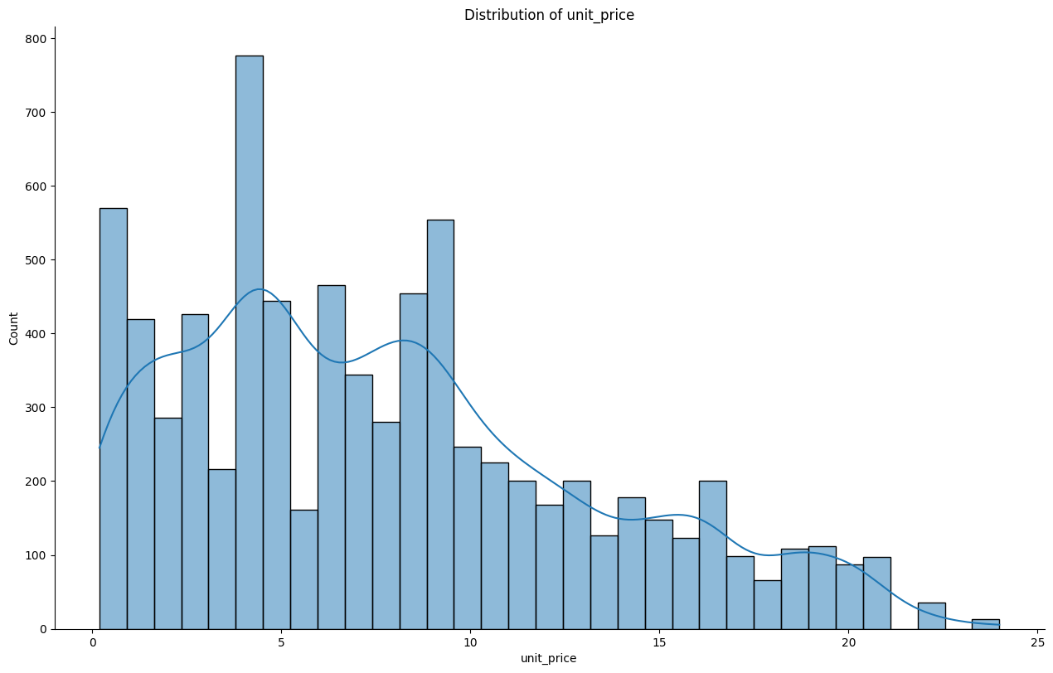
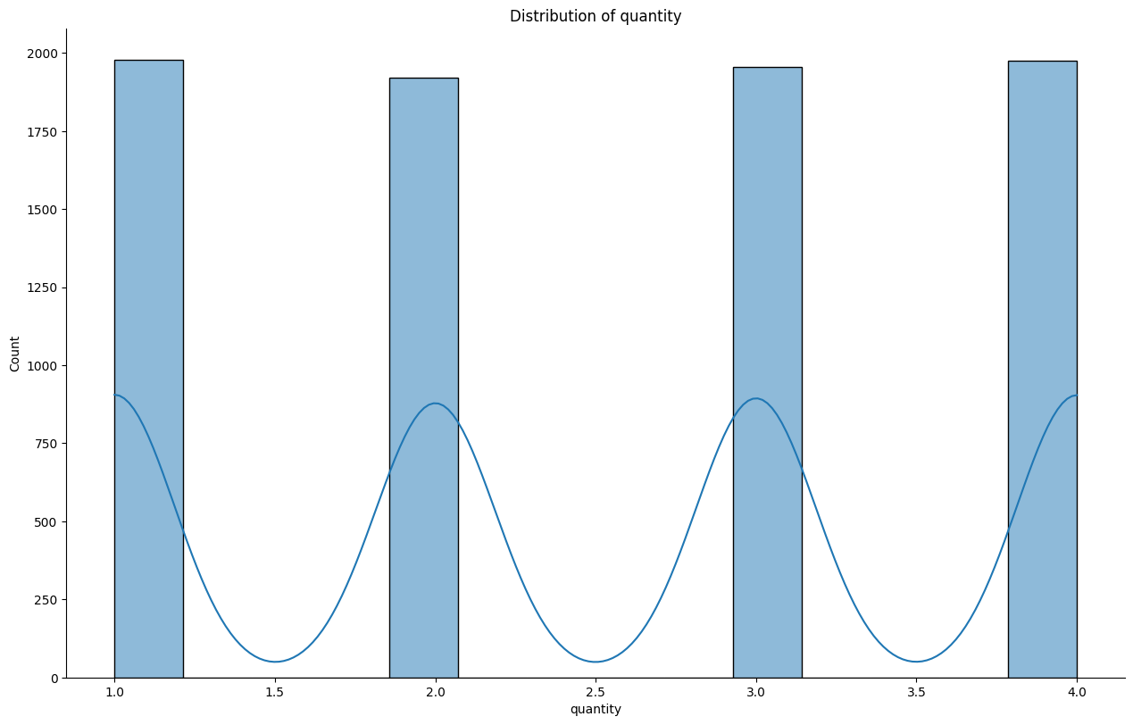
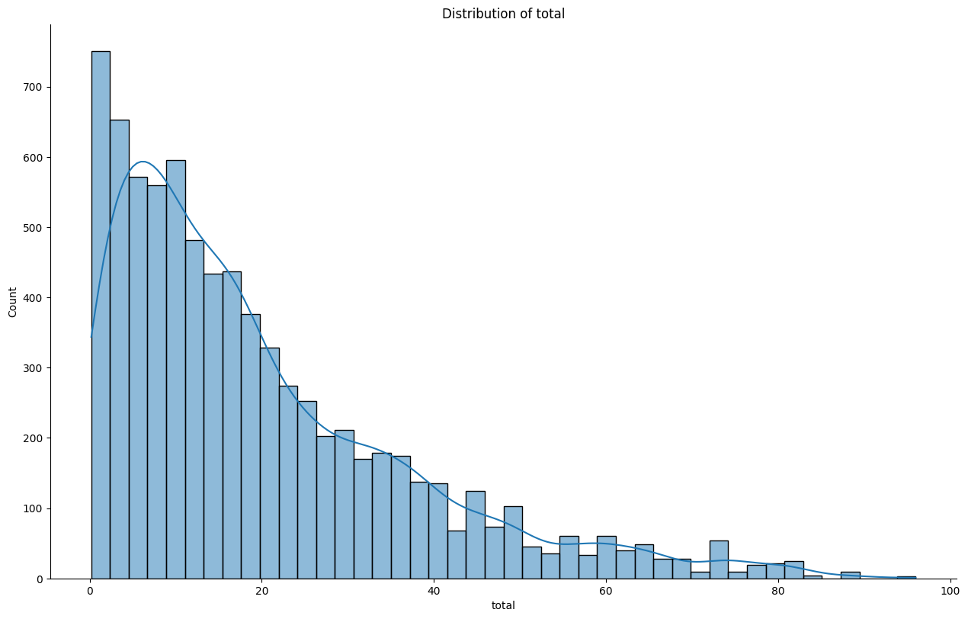
Analyzing the data
Distribution of prices and quantities:
unit_price: Positively skewed with more sales for cheaper products.
quantity: Almost uniform distribution with 1-4 units bought equally often.
total: Even more positively skewed than unit_price, indicating more transactions with lower totals.

Slide 7
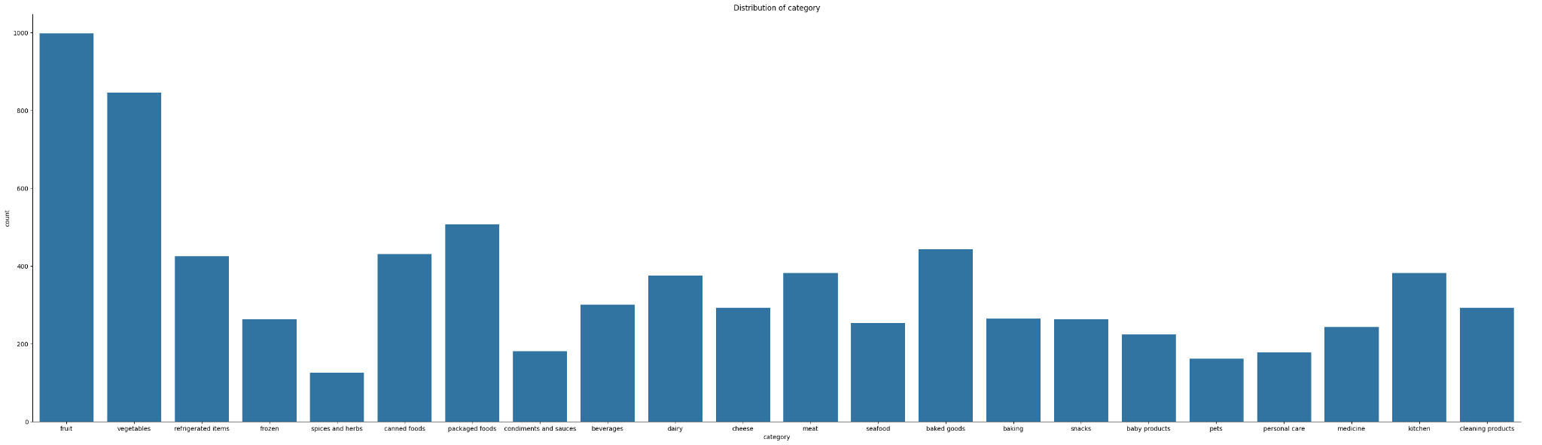
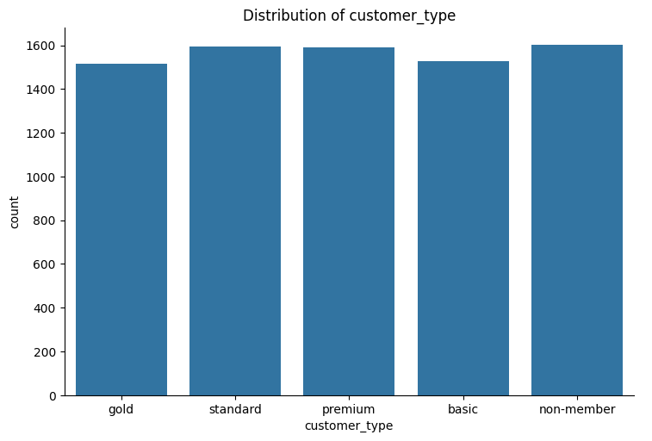
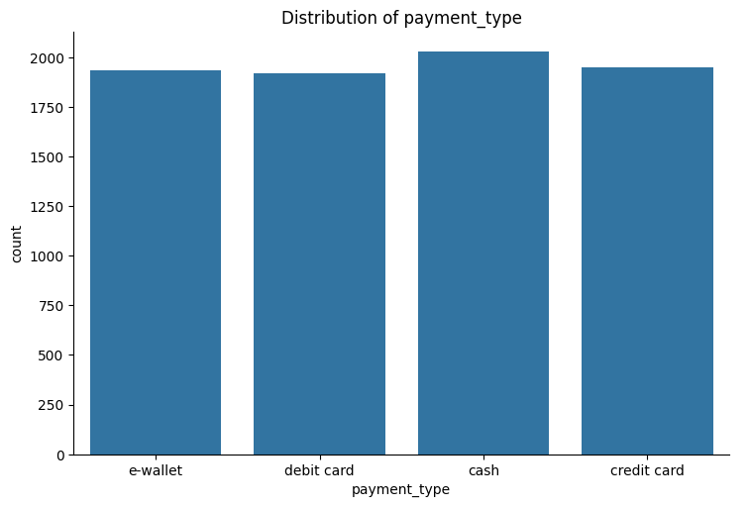
Analyzing the data
Categorical variables:
product_id: 300 unique products, with one product sold 11 times and another just 3 times.
category: 22 unique categories, with "fruit" and "vegetables" most popular and "spices and herbs" least popular.
customer_type: 5 evenly distributed types, with non-member slightly more frequent.
payment_type: 4 evenly distributed types, with cash most frequent and debit card least frequent.
timestamp: Lots of unique values suggesting a datetime format, with busiest hours around 11th, 16th, and 18th of the day.

Slide 8
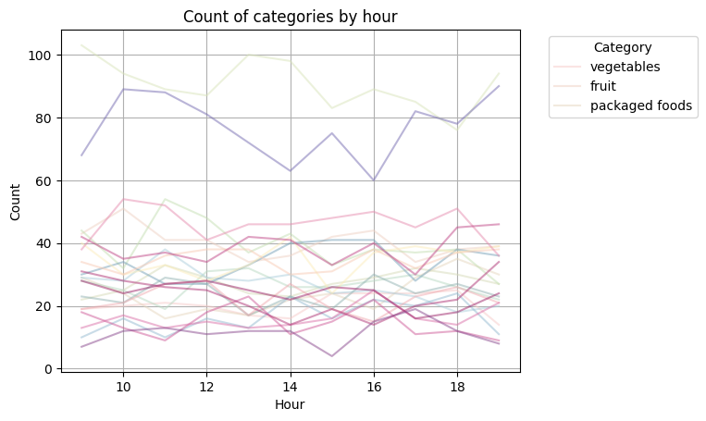
Analyzing the data
Categorical variables:
We can see clearly that vegetables and fruit are the most buyable items in all hour.

Slide 9
Limitations and next steps
Data limitations:
Sample size: Only 1 week of data from 1 store, making insights unreliable.
Problem statement lacking specificity: The current "better stocking" goal is too broad.
Feature limitations: More features relevant to the specific problem might be needed.
Recommendations:
Gather more data: Collect data from multiple stores and a longer period to gain statistically significant insights.
Refine the problem statement: Define a specific goal like optimizing stock for peak hours or predicting demand for high-value items.

Slide 10
Based on our recommendations, Client wants to focus on the following problem statement:
“Can we accurately predict the stock levels of products based on sales data and sensor data on an hourly basis in order to more intelligently procure products from our suppliers?”

Slide 11
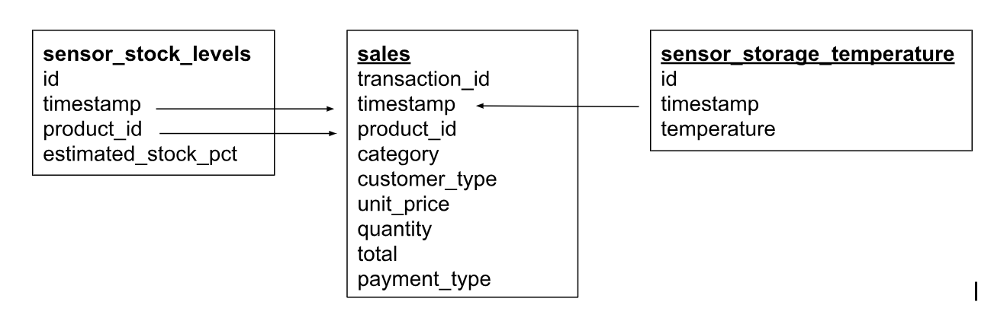
Data model diagram
Client adds valuable data: Sensor readings from warehouse & store stock levels ️

Slide 12
Hypothesis
Product price: Product price may be related to product inventory levels. Cheaper products may have higher demand and therefore need to be stocked more.
Product quantity: Product quantity may be related to product inventory levels. Products sold in larger quantities may need to be stocked more.
Time of day: Time of day may be related to product inventory levels. Products that are sold more at certain times of the day may need to be stocked more.
Sensor data: Sensor data about the warehouse and store may be related to product inventory levels. For example, warehouse temperature can affect product shelf life and therefore needs to be considered when forecasting demand.

Slide 13
02
Modeling

Slide 14
Strategic Plan
Data Pipeline
Modeling Workflow
Deployment & Monitoring
Merge: Combine data from "sales", "sensor_storage_temperature", and "sensor_stock_levels" based on product_id and location.
Clean & Transform: Handle missing values, outliers, and feature scaling.
Engineer Features: Extract relevant features (e.g., demand seasonality, temperature impact).
Experiment: Train and compare various predictive models (e.g., demand forecasting, spoilage prediction).
Cross-validate: Assess model performance on unseen data.
Evaluate & Iterate: Optimize hyperparameters and select the best performing model.
Productionize: Package the chosen model as an API for deployment.
QA & DevOps: Validate model performance and integrate with existing systems.
Monitor & Feedback: Continuously monitor model performance and iterate based on new data.

Slide 15
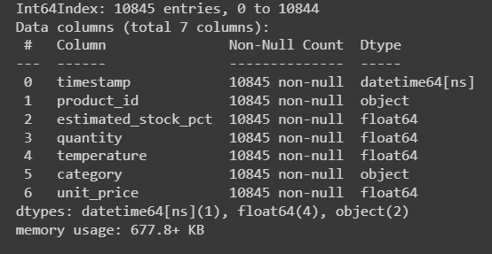
Merged Data
Combined all 3 datasets using timestamps.

Slide 16
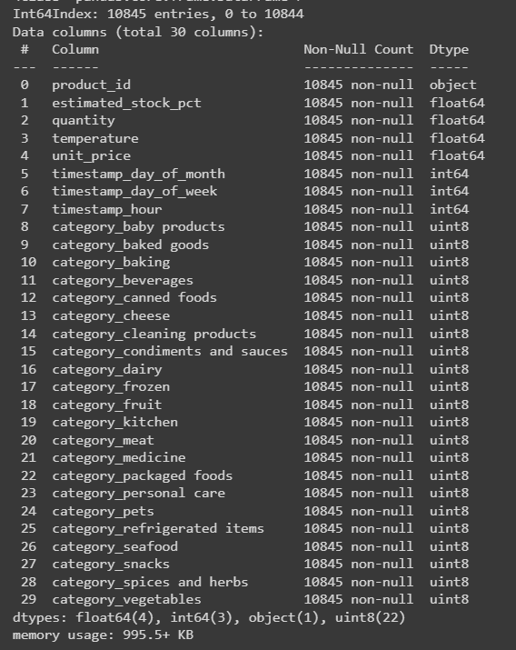
Feature Engineering
Transformed timestamps to day, month, hour.
Created numerical features from categorical data.

Slide 17
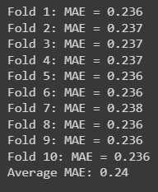
Model Training
Used Random Forest Regression with cross-validation (K-folds).
Achieved consistent Mean Absolute Error (MAE) ~0.25 (50% accuracy).

Slide 18
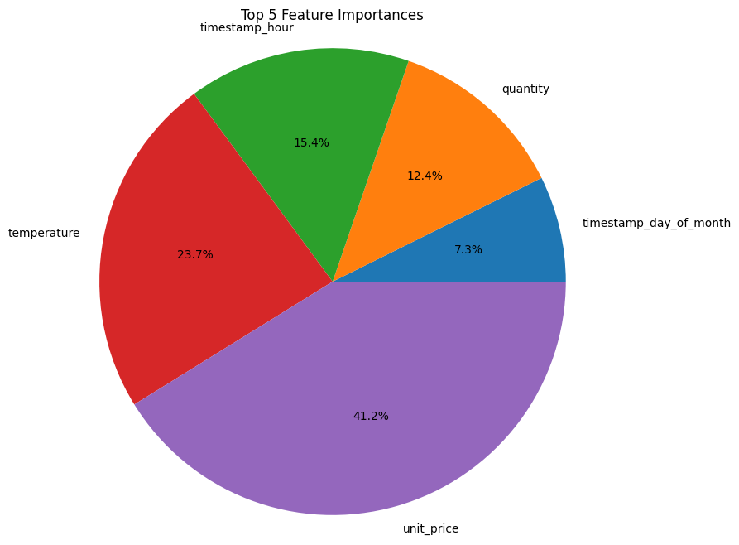
Model Results
Key Insights:
Next Steps:
Model is robust: Performs consistently across different data samples.
Important features: Unit price, temperature, hour of day.
Prediction accuracy: Moderate (50%), needs improvement.
Refine feature selection and engineering for better accuracy.
Explore different machine learning models for potential improvement.
Develop and implement an hourly stock prediction dashboard.

Slide 19
Evaluate and improve
Data Inclusion
Algorithm Exploration
Deliveries: Directly impacts stock levels and likely changes based on weather patterns.
Weather: Influences customer behavior and demand for specific products.
Explore:
Neural Networks: Highly complex and potentially more accurate than Random Forest.
Considerations:
Interpretation difficulty compared to Random Forest.
Requires careful hyperparameter tuning and resource availability.

Slide 20
Evaluate and improve
Model Interpretation
Performance Optimization
Limitations:
Neural networks offer less interpretability than Random Forest.
Alternatives for Random Forest:
Feature importance analysis to identify key decision-making factors.
Optimize Random Forest:
Hyperparameter tuning: Adjust parameters like number of trees and features per split to improve MAE.

Slide 21
Thank you for listening!

